Slide 1
Changing Lives through Responsible Tourism
Jennifer Seif: Executive Director, Fair Trade Tourism
31 March 2015

Slide 2
Fair Trade Tourism (FTT)
Africa’s Leading Sustainable Tourism Organisation, since 2001
Market development through SME support, training, awareness, advocacy market access
World’s first (and still only) tourism Fair Trade standard and label: the people whose land, labour, culture and natural resources are used for tourism reap the benefits.
Available in a growing number of African destinations: competitive advantage
www.fairtrade.travel

Slide 3
Tourism impacts
Job creation (decent work?)
Poverty reduction
SME development (supply chains)
Investment
Rural development
New infrastructure
GDP contribution
ECONOMY
Skills development
Access by women and youth
Inequality, competition over resources, exclusion
Competition over resources
Commodification vs protection of culture/heritage
Protection of vulnerable groups
ENVIRONMENT
Resource consumption
Waste, noise/air pollution
Biodiversity
Protection of pristine landscapes & eco-systems
GHGEs
SOCIETY

Slide 4
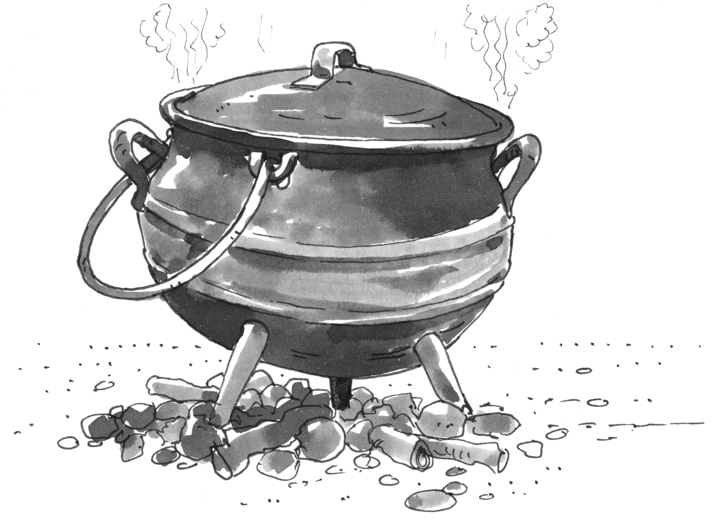
People, planet, profit

Slide 5
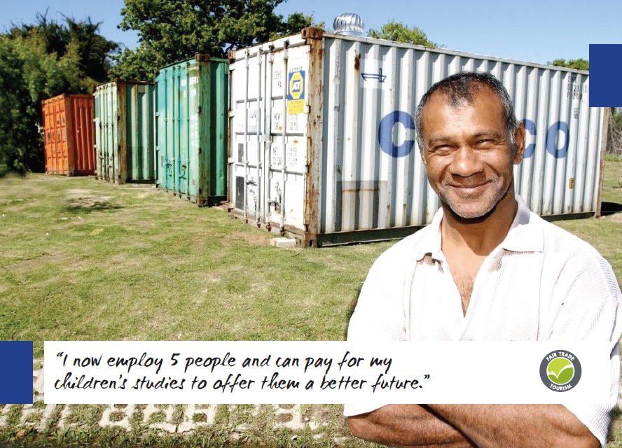
Bernie Samuels, Spier Wine Estate

Slide 6
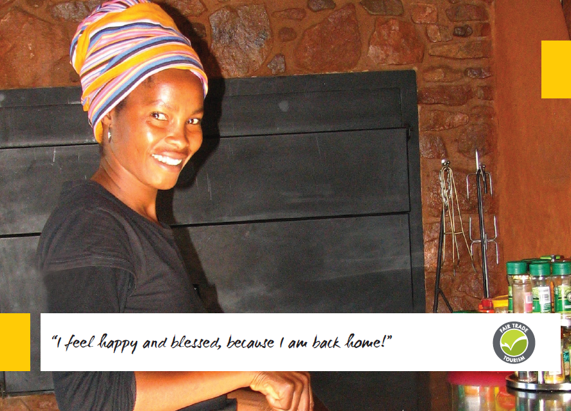
Joyce Mulaudzi, Leshiba Wildnerness

Slide 7
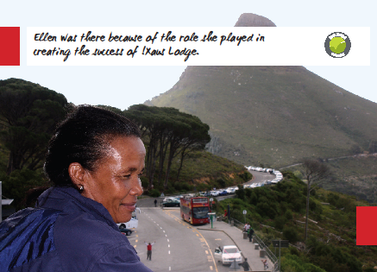
Ellen Bok, !Xaus Lodge, Kalagadi

Slide 8
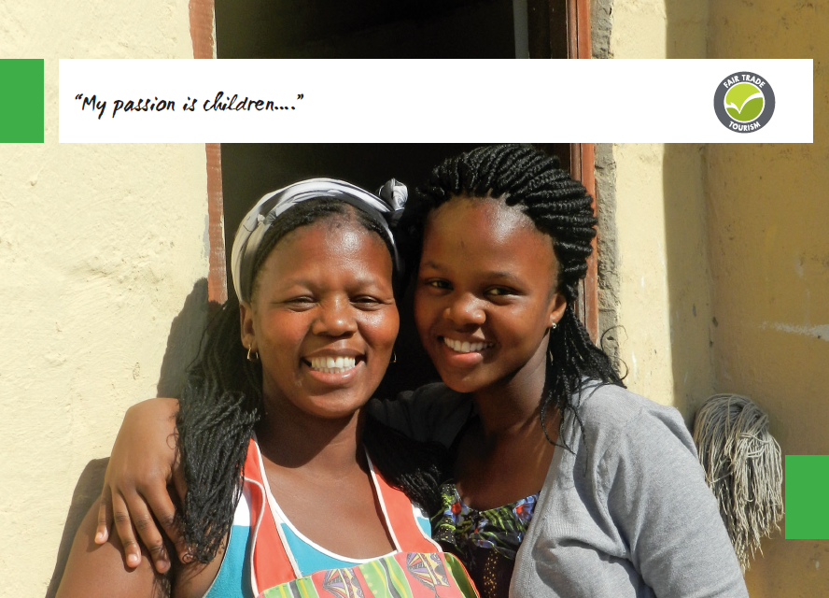
Phumla Pakamile, Volunteer Africa 32 ⁰ South,
Wild Coast

Slide 9
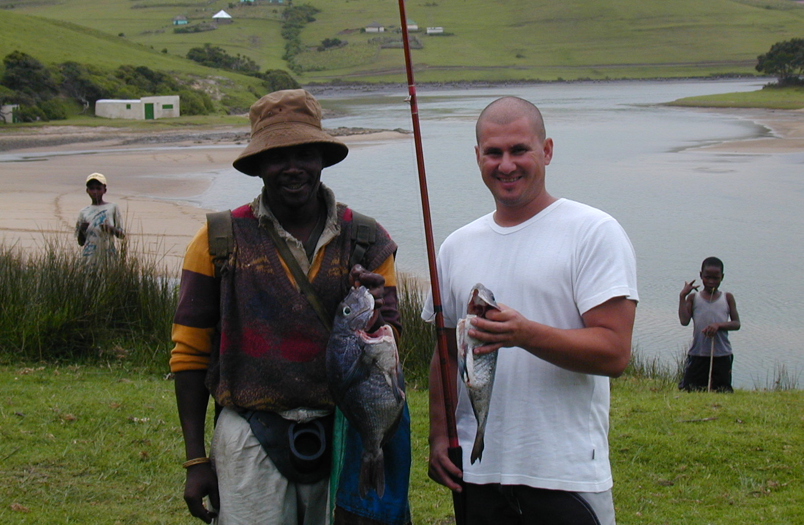
Bulungula Lodge, Wild Coast

Slide 10
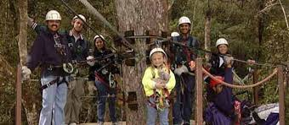
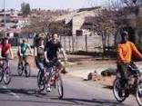
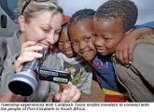
Stormsriver
Adventures,
Tsitsikamma
Lebos Bicycle Tours, Soweto
Calabash Tours, NMB

Slide 11
Partnerships: Local Gov’t
Product development
Business Development Support
Training
Market knowledge
Peer networking
Certification – cluster development
Market advantage
New value chains
Destination USP
Joint marketing
Collective Impact!!!!!!!!!
www.fairtrade.travel
info@fairtrade.travel

